Slide 1


Hyrje ne Javascript
01
JAVASCRIPT
Powered By

Slide 2
Content
Variables: let, const, var
Data Types: Primitive Data Types
Operatore bazik ne Javascript
Arithmetic Operators
Assignment Operators
String and Template Literals
If Statements: if, else if, else
Switch Statements
Comparison Operators
Logical Operators
String methods
JavaScript Challenges

Slide 3
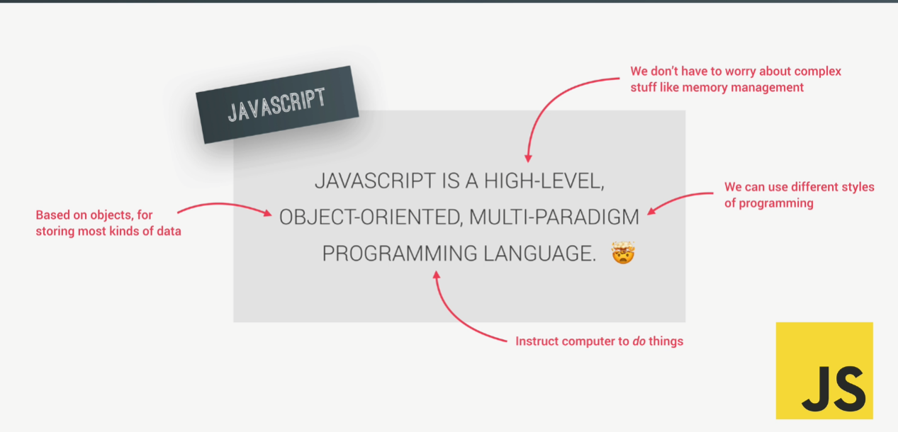

Slide 4
Variables: let, const, var
let a = something
const b = something else
var = 1234
Kur deklarojm Variablen me const, nuk mund te is ndryshojme vleren me vone

Slide 5
Data Types: Primitive Data Types
Numbers: 123
String: “dfdf”
Boolean: true ose false
Undefined: empty value
Null: null empty value
Symbols: (useful for now)
BigInt: Larger integers
Ne Javascript nuk kemi nevoje qe te shkruajme tipin e te dhenanve

Slide 6
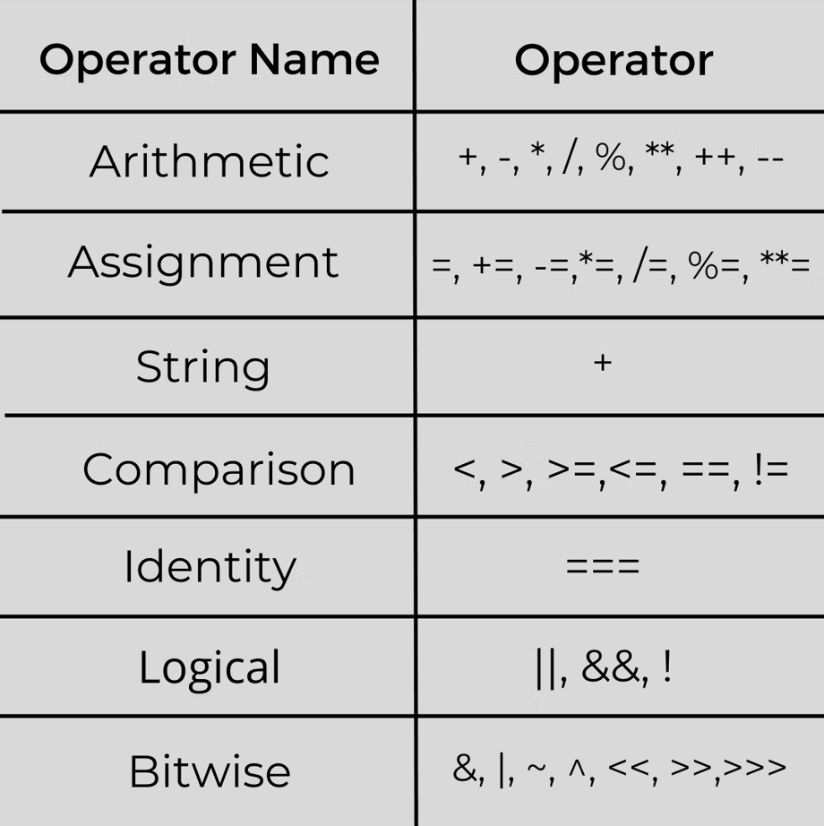
Operatore bazik ne Javascript

Slide 7
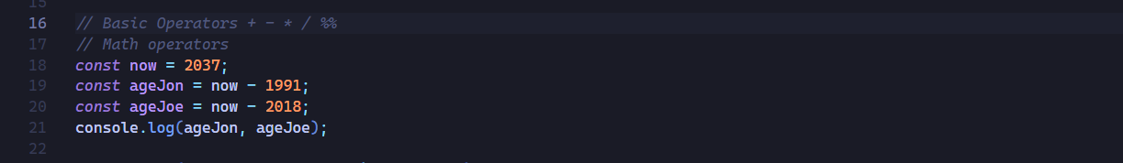
Arithmetic Operators:

Slide 8
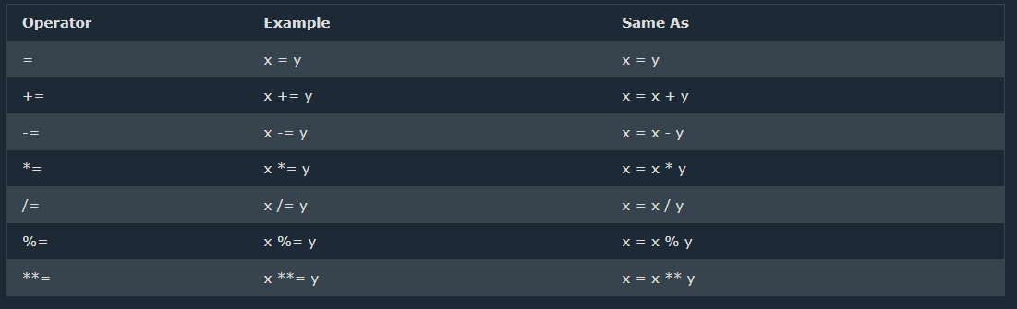
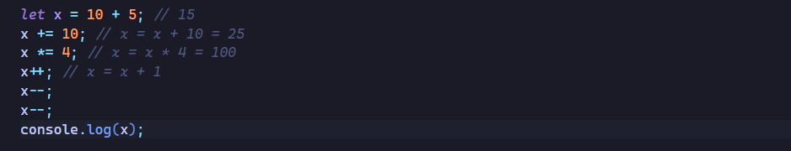
Assignment Operators:

Slide 9
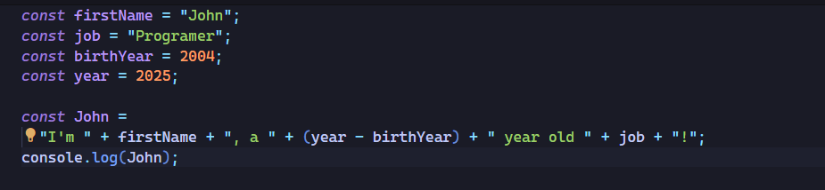
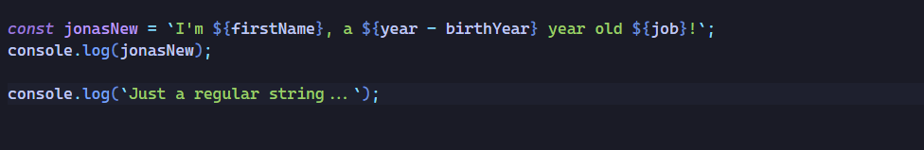
String and Template Literals

Slide 10
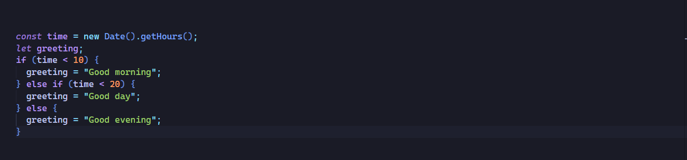
If Statements: if, else if, else

Slide 11
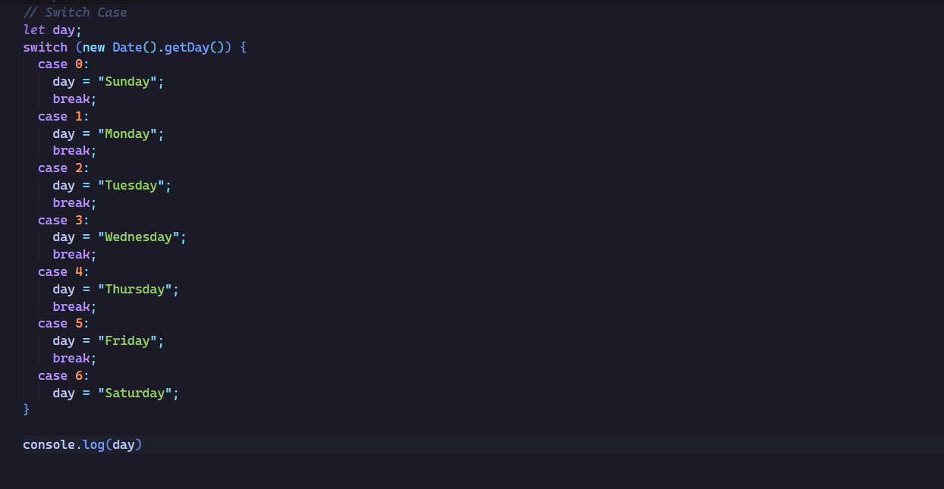
Switch Statements:

Slide 12
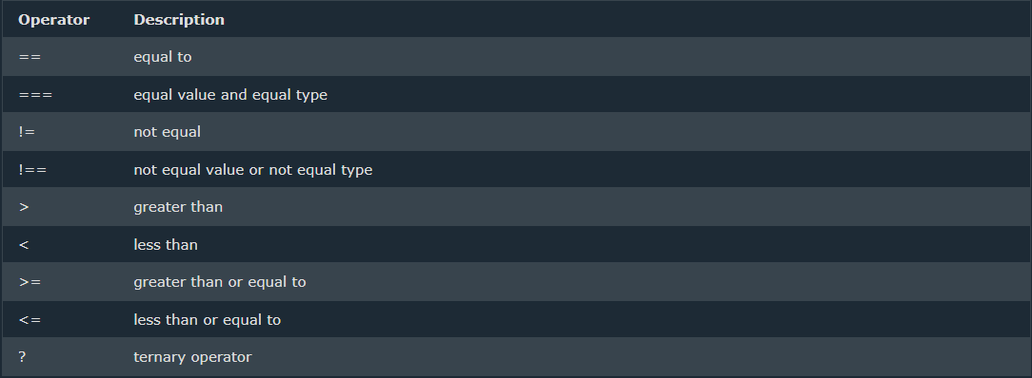
Comparison Operators:

Slide 13
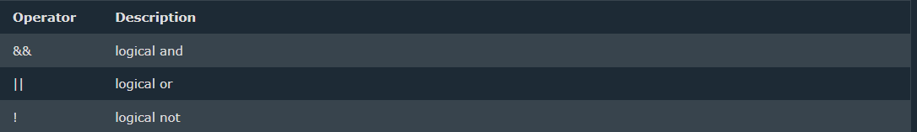
Logical Operators:

Slide 14
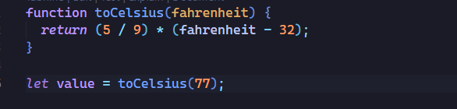
Function in Javascript:

Slide 15
String methods:
String toUpperCase() String toLowerCase() String concat() String trim() String trimStart() String trimEnd() String padStart() String padEnd() String repeat() String replace() String replaceAll() String split()
String length String charAt() String charCodeAt() String at() String [ ] String slice() String substring() String substr()

Slide 16
15
FALEMINDERIT PER VEMENDJEN!

Slide 17
www.w3schools.com

